Slide 1
I hate group projects! A solution to group work angst using interdisciplinary consulting as a guide
Jill Lundell & Brennan Bean

Slide 2
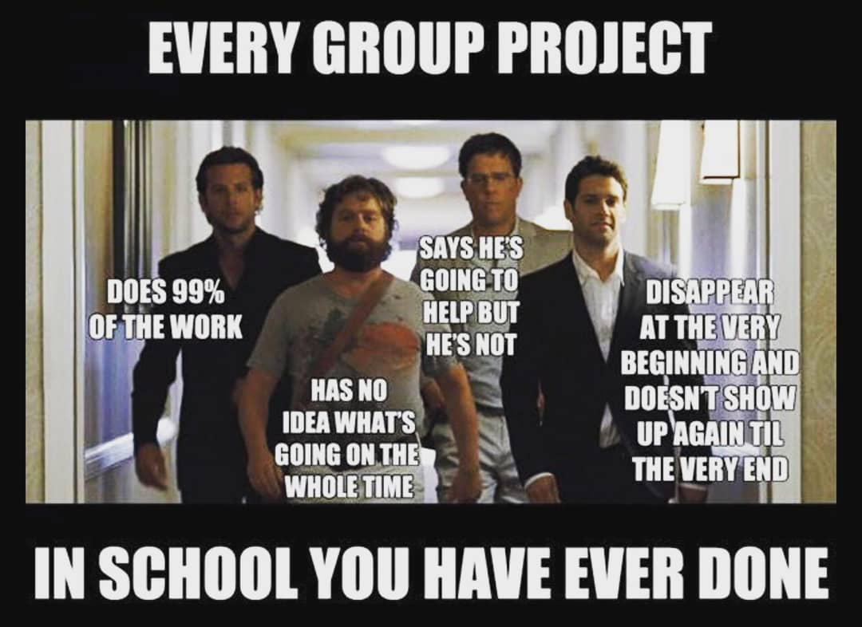
We all hate group projects

Slide 3
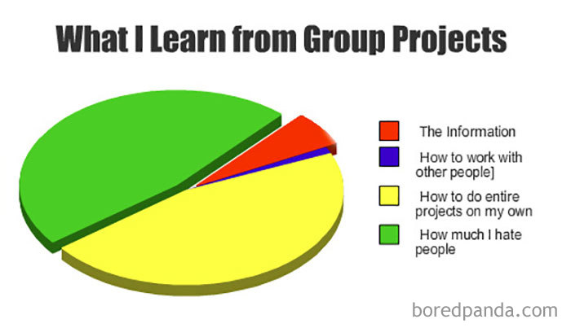
Group work is assigned to teach us to work in groups when we get jobs, but what we really learn is:

Slide 4
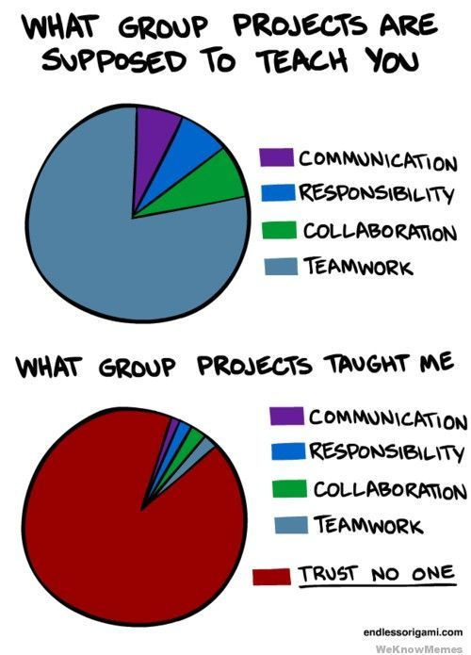
Education research on group work
Do not allow students to choose their own groups
Have students interact outside of groups so they have some sort of relationship before the project begins
Have students report on the participation of each group member
This helped, but it was not enough

Slide 5
Principle question
Why do group projects work at work but fail at school?

Slide 6
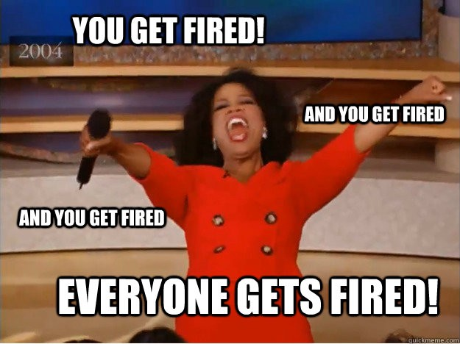
Why do they work?
Everyone has a specific job on the project
We support each other with our individual tasks
Weekly meetings
Everyone reviews all of the work on a regular basis
Fixed deadlines with clear action items
Accountability for each member of the group
Note: Groups do not always work at work. The stakes are high in consulting. If you cannot do quality work in a short amount of time the contract will be awarded to someone else and you will go out of business. This is understood by everyone. You figure it out, or you are canned.

Slide 7

Group structure
Create groups soon after the first week of class (3-5 per group)
No one should be adding the class at this point
One week of attendance and participation
Group members should have something in common: I look at major and diversify across class rank (FSJS)

Slide 8

Getting Acquainted
Have groups find each other in class and sit with each other
Give 5-10 minutes for them to get to know each other and exchange contact information
Explain that this is their support group for the class and what that means
Assign group tasks together at least once a week (quizzes, group worksheets)
They have to sit by each other every day in class
Do group activities in class periodically through the semester

Slide 9
Setup of project
Carefully design project and separate it into several weekly assignments – there must be more assignments than group members and an assignment due at least once a week
Each student knows who is responsible for each assignment
Each student must submit something every week
Deadlines are critical - no credit for late work
Every student must present their part in the final presentation
Every student must answer a question about another student’s part of the project
Each student must review the other group members

Slide 10
Setup of project – simple statistical study
Proposal: Information quiz, project approval (done in person), assign individual tasks
A1: Submit slides introducing project
A2: Collect data
A3: Submit slides with data collection information and issues in collecting data
A4: Select a statistical test (meet with instructor)
A5: Submit slides with preliminary data analysis
A6: Submit slides with statistical test and results
A7: Submit rough draft of class presentation
A8: Submit final presentation slides and present
A9: Submit group member evaluation

Slide 11
Let the games begin
Make sure the project is started early enough
If there are 7 assignments it must start at least 8 weeks before the end of the semester
Have the students read the instructions and take a detailed quiz on them
They must get 100% to proceed with the class
Give them time in class to get things organized as a group
Have a Google Drive spreadsheet where they sign up for each assignment (this is also an assignment)
This is imperative! You need to know who is handing which part in and it makes sure the group is clear. The group can juggle assignments through the project, but they must update the spreadsheet

Slide 12
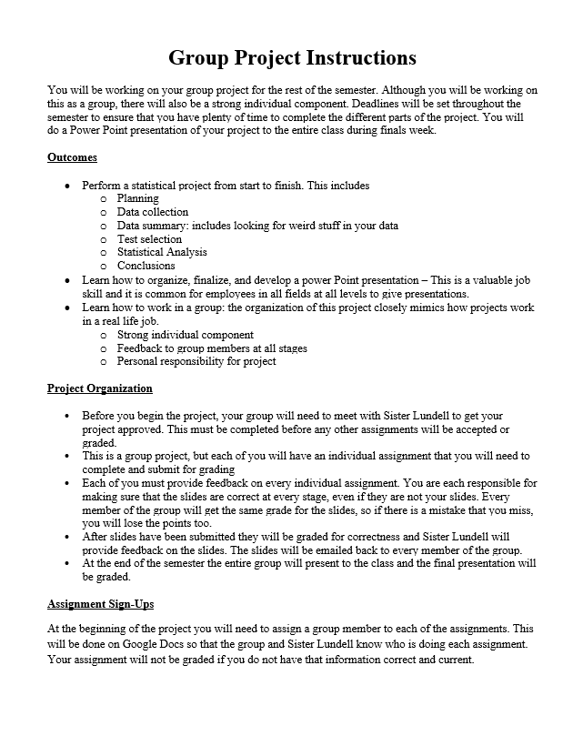
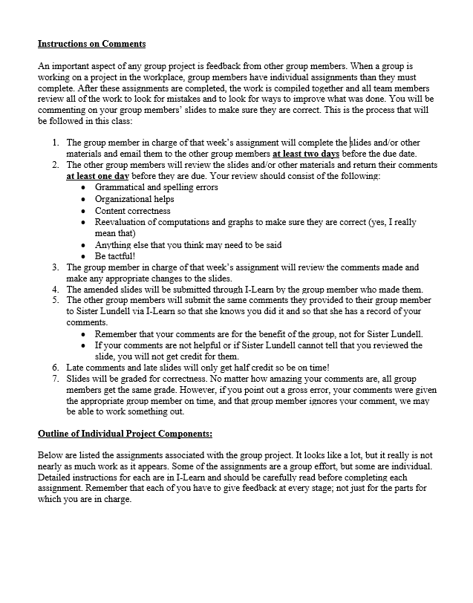
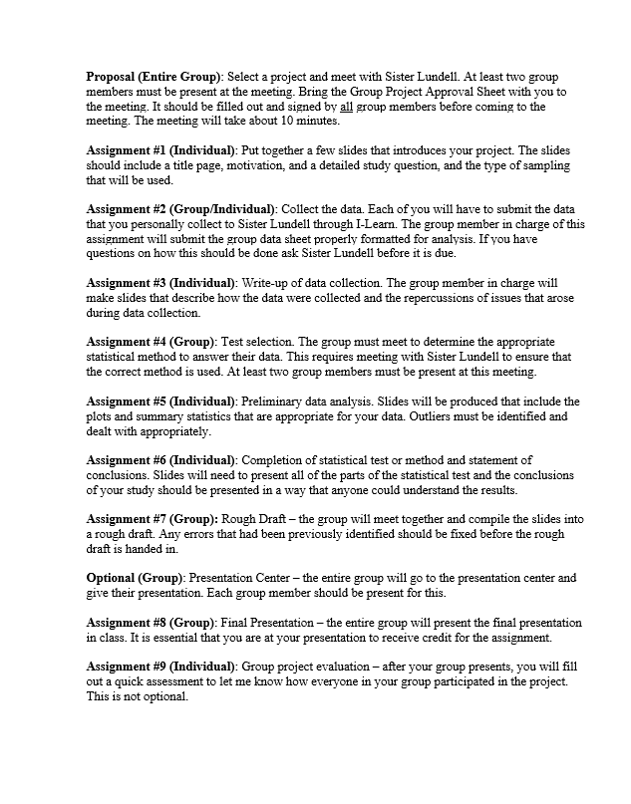
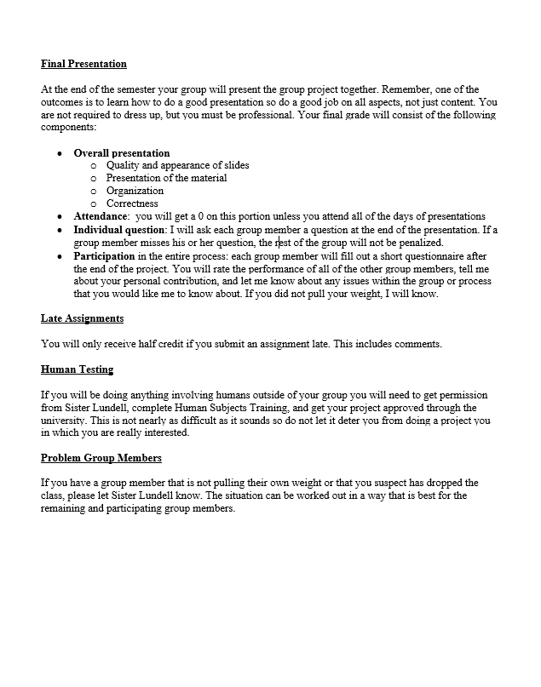
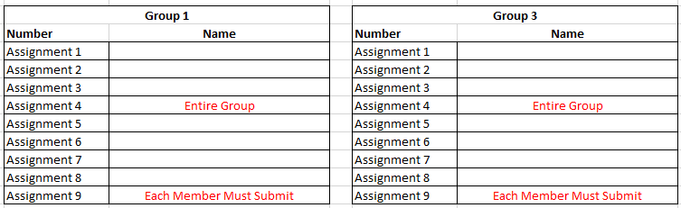

Slide 13
Weekly responsibilities
Wednesday: Assignment needs to be completed and sent to group members for review
Thursday: Each group member must review the assignment and give their review to their group member
Feedback like, “Look’s great!” is worth 0 points because they didn’t review it
Friday: Assignments are submitted to Canvas
Person in charge of that week’s assignment hands in the assignment
Other group member submit Thursday’s review on Canvas
All assignments are worth the same amount of points – not reviewing is costly
A mistake on the assignment is a mistake for everyone, unless you call it out in your review (everyone else misses the points, but you are safe)

Slide 14

Use the gradebook to motivate
Week 1 complaint: I did the assignment and none of my group members would comment or do anything!
Week 2: Group members get 0 in the gradebook and course grades drop from A to C overnight
Frustration ensues when stressed students want a chance to hand it in late and their request is denied
Explain that a review after the assignment is submitted is useless
By the end of the project this 0 will have little impact on their score, but the sudden drop in their overall grade is a huge motivator
Week 2 complaint: There usually aren’t any

Slide 15
What about group members who don’t do anything?
Missing or unhelpful reviews get 0 points
Late assignments get 0 points
Students who get assignments to the group late or who submit reviews late get grade penalties
Group members who point out an error and are ignored are not penalized for the error
Group members who fail to point out a mistake lose the points for the mistake
If a group member does not submit the assignment, they get a 0. The other group members have a few days to complete and submit the assignment with no penalty.

Slide 16
Group member evaluation
Each student was required to evaluate each of their group members
They submitted the answers to 3 questions
Tell me something that went well in your group
Tell me something that did not go well in your group
Tell me how much effort each group member put into the project by dividing up 100 points between them (do not include yourself)
Their grade for this part of the assignment was based on feedback from group members

Slide 17
Miscellaneous observations
Add a short quiz to each review assignment
Did your group member get you the materials by the due date
Have them answer for each group member
Automatic deduction if they don’t
Don’t assume students know how to work in a group or organize a project
Nobody has taught them how to do it
Spell it out for them in detail
You are training them how to be a good worker
Fast and thorough feedback is Essential!
Note when they miss deadlines or tasks
Heavily comment on submitted assignments so they can learn

Slide 18
Teacher Observations
Students liked that the project was not overwhelming
Small weekly assignments prevented gross procrastination
It was rare that a student did not do their part
Gradebook motivation and fast grading is essential
Timely feedback from me was crucial
Make many comments on slides
Email group members whenever there is an issue
Clear expectations in writing are vital
Students learn how a project is organized instead of being thrown to wolves

Slide 19
Student Observations (Comments from A Student Participant)
Groups became “self-enforcing” - naturally balanced the workload.
Well defined roles
Well defined expectations
Well defined consequences
Group relations were less tense because we didn’t have to enforce the rules ourselves.
Due dates spread over long period of time reduced anxiety.
Group-member evaluations were still tough, but at least based on objective guidelines.

